Slide 1


Python Data Analysis with Pandas
Welcome to this beginner-friendly guide to data analysis with Python! We'll explore the powerful Pandas library and how it can transform your programming journey.
by EMRE Akpınar

Slide 2
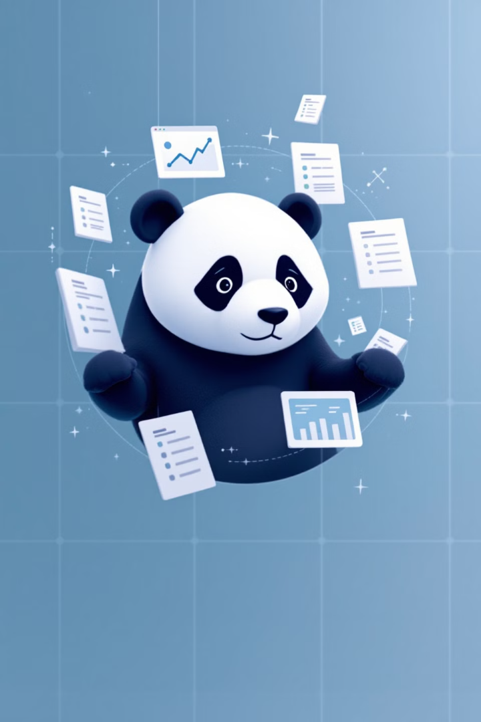
What is Pandas?
Data Structure Library
Data Processing
Pandas is a Python library for data manipulation and analysis. It provides efficient data structures for handling tables and time series.
It enables quick and easy processing of structured data. Operations that would take many lines of code become simple.
Essential Tool
It's a must-know tool for any data scientist or analyst. Most Python data workflows include Pandas.

Slide 3





Key Features of Pandas
DataFrame Structure
Data Filtering
Data Integration
Filter, sort, and extract data subsets. Handle missing values with ease.
Merge, join, and combine datasets efficiently. Perfect for working with multiple data sources.
Process data using indexed table-like structures. These make data manipulation intuitive.
Time Series
Special support for time series data. Convert frequencies and perform time-based operations.

Slide 4

Getting Started with Pandas
Install Pandas
Open your terminal and run: pip install pandas
Import the Library
In your Python script, add: import pandas as pd
Create Python File
Start a new file (e.g., data_analysis.py) to write your Pandas code.

Slide 5
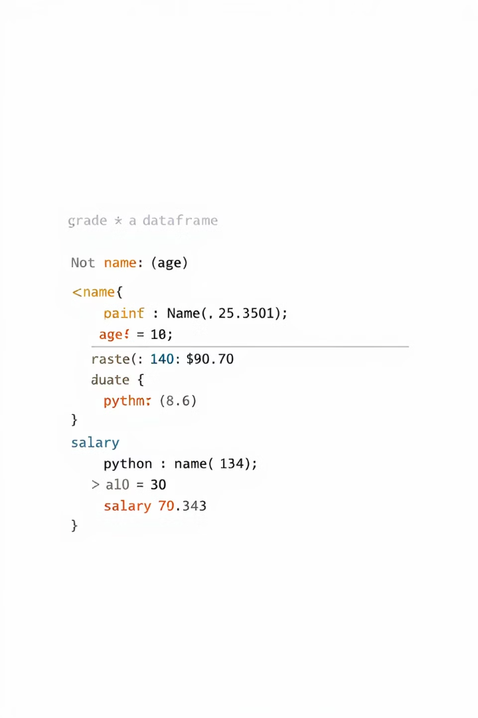
Creating DataFrames
1
Define Your Data
Create a dictionary with lists for each column. Include keys for column names.
2
Convert to DataFrame
Use pd.DataFrame() to transform your dictionary. This creates the table structure.
3
Explore Your Data
Print the DataFrame to see your tabular data. Notice the automatic indexing.

Slide 6
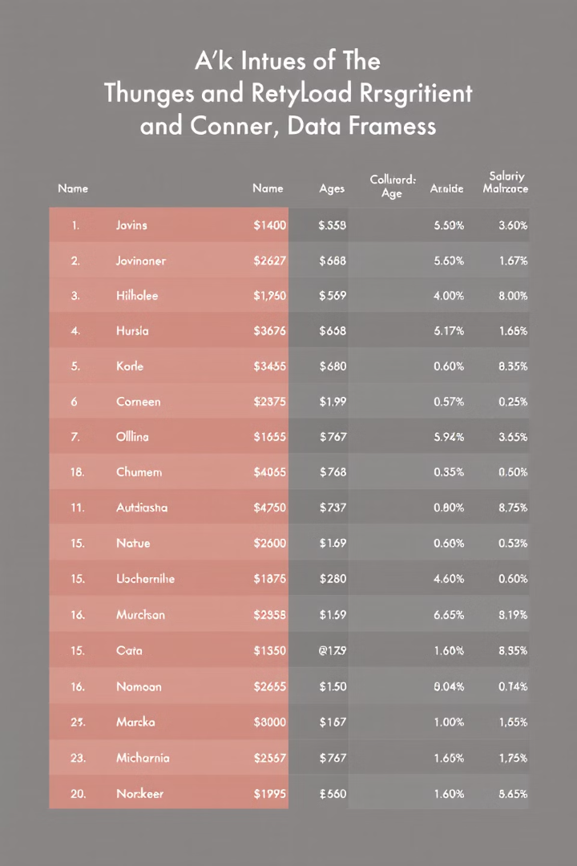
Sample DataFrame Code
# Creating a dictionary for personnel data personnel = { "Name": ["Burak", "Gamze", "Aslı", "Önder", "Eylül"], "Age": [29, 20, 27, 25, 20], "Salary": [5000, 4000, 4500, 6000, 5500] } # Converting to DataFrame df = pd.DataFrame(personnel) # Printing the result print(df)

Slide 7
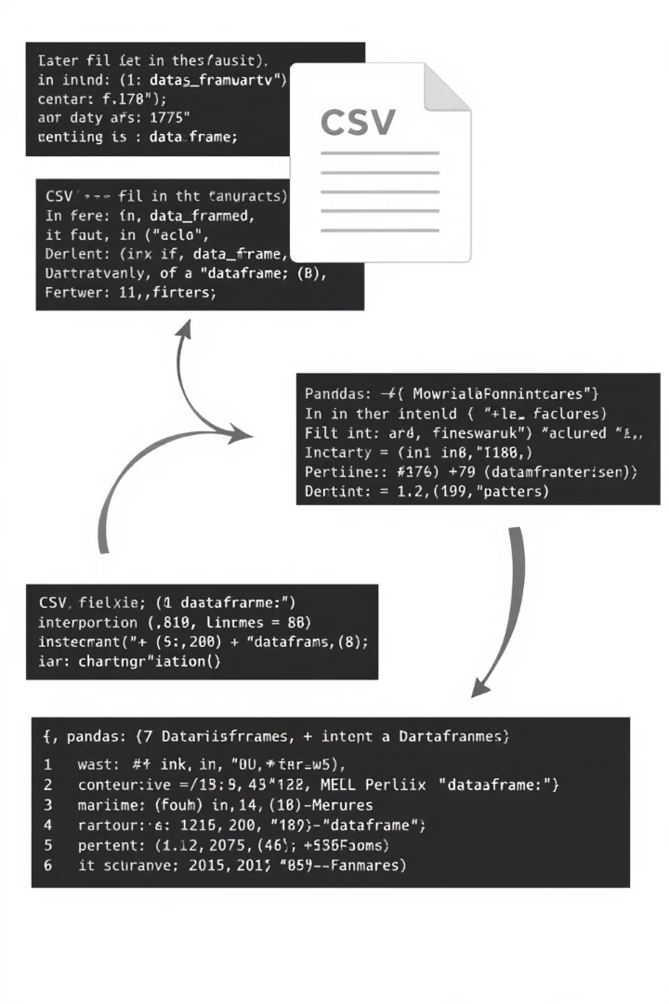




Working with CSV Files
Create CSV File
Prepare your data in Excel or a text editor. Save as CSV format with headers.
Read CSV into Pandas
Use pd.read_csv("filename.csv") to import the data. Specify delimiter if needed.
Manipulate Imported Data
Work with the data just like any DataFrame. All Pandas features apply.
Save Modified Data
Export back to CSV using df.to_csv("new_file.csv") when needed.

Slide 8
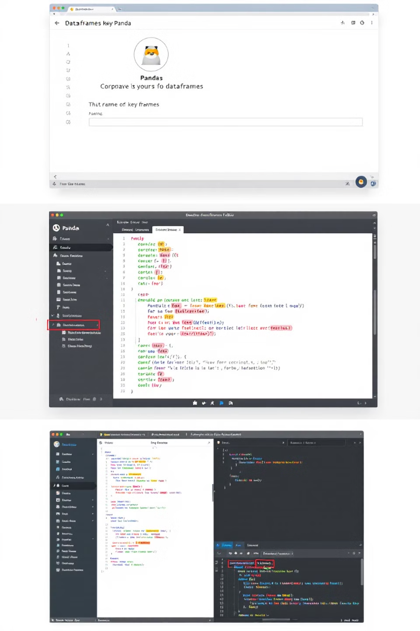
Essential Pandas Methods
Viewing Data
Use df.head() and df.tail() to see first or last rows. Perfect for quick inspection.
Data Information
Try df.info() for structure overview. Use df.describe() for statistical summary.
Selection & Filtering
Select with df["column"] or df[df["Salary"] > 4000]. Filter based on conditions.
Calculations
Calculate with df.sum(), df.mean(), or df["column"].max(). Analyze numeric data easily.

Slide 9
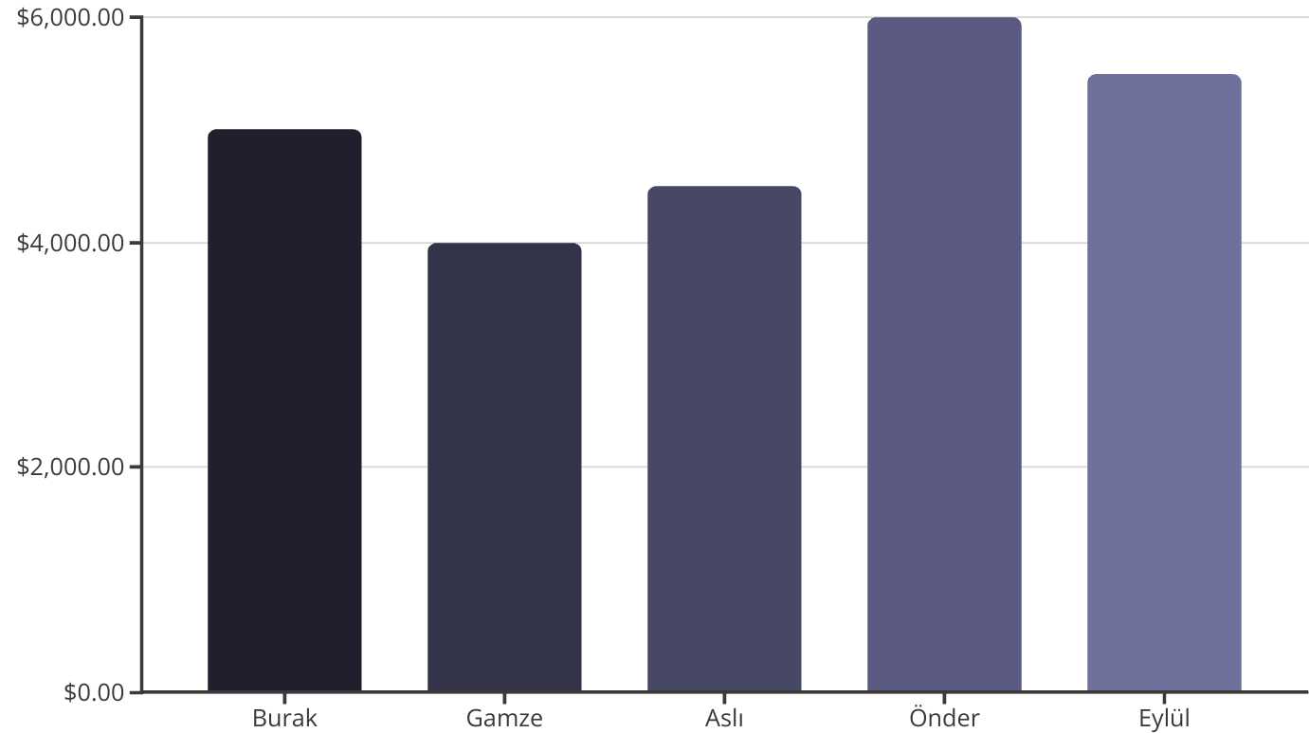
Practical Example
This salary data visualization was created using Pandas and a visualization library. Filter, sort, and analyze this data with just a few lines of code.

Slide 10




Next Steps with Pandas
Advanced Analysis
1
Time series, groupby operations, and complex transformations
Data Visualization
2
Combine Pandas with Matplotlib and Seaborn
Data Cleaning
3
Handle missing values and transform data
Basic Operations
4
Creating, reading, and filtering data
You've learned the basics of Pandas! Continue exploring its features to enhance your data analysis skills. Join us in the next lesson!

